Slide 1
Updating the MA DG Interconnection Report
DOER analysis of the Utility reporting of DG interconnection projects following the Expedited and Standard Review Processes from January 1, 2009 to May 1, 2012*
Presentation to the DG Working Group - May 31, 2012
Gerry Bingham, Senior Coordinator / Distributed Generation
* This analysis does not include applications submitted before
January 2009 or projects following the Simplified Process (<10 kW
on single-phase lines and <25 kW on three-phase lines after Jan 2009).
The DG Report summarized projects through 2010 and is available at
the MA Interconnection and Distributed Generation Website.

Slide 2
Figure 4.22 (2009-May 2012) Applications by Year and Company (Standard and Expedited)

Slide 3
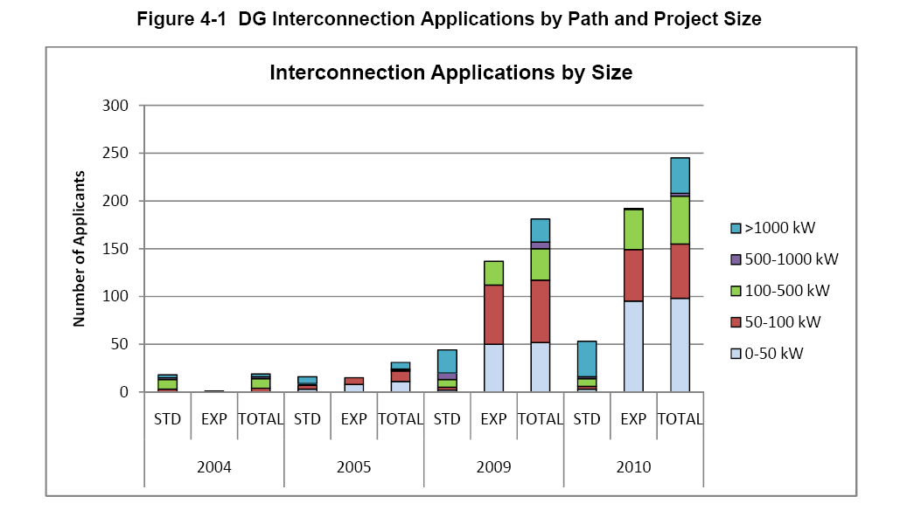

Slide 4
Figure 4.1 (2011-April 2012): Capacity of Projects By Size (kW)
*NOTE: 92 projects (208 MW) have not yet been assigned a process.

Slide 5
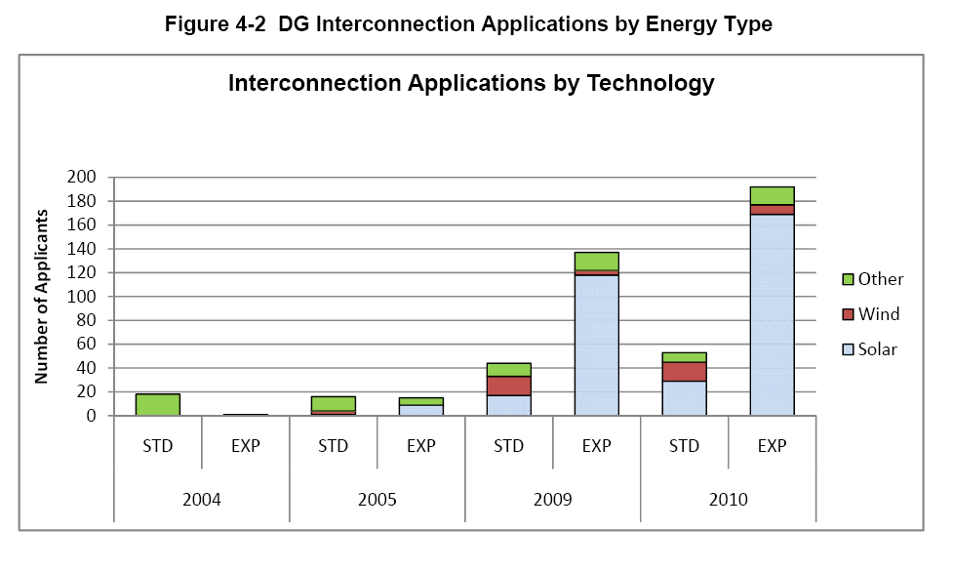

Slide 6
Figure 4.2 (2011-April 2012): Number of Applications By Technology
*NOTE: 92 projects (208 MW) have not yet been assigned a process.

Slide 7
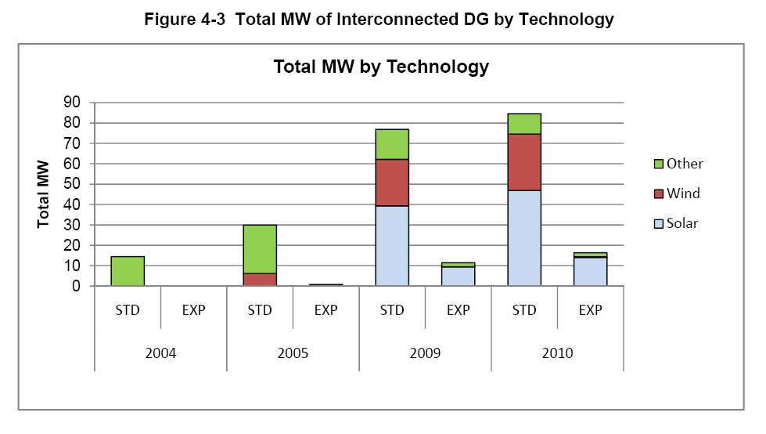

Slide 8
Figure 4.3 (2011-April 2012): Capacity of Projects by Technology (kW)

Slide 9
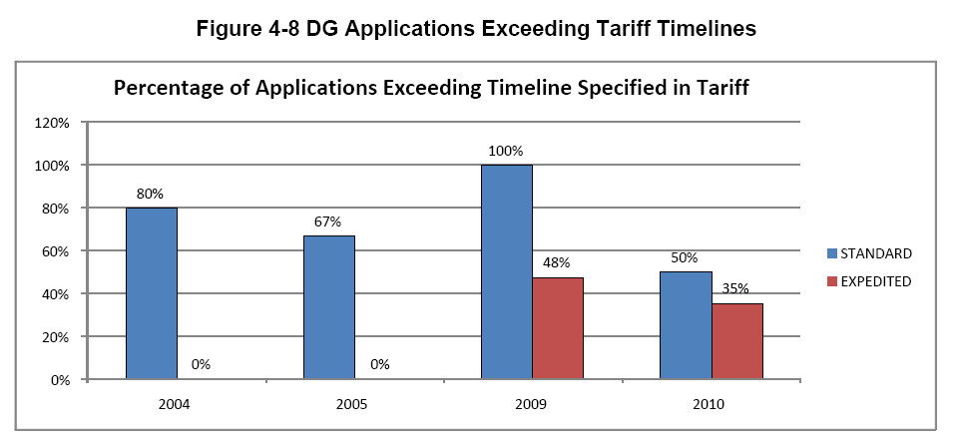

Slide 10
Figure 4.8 (2011-April 2012): Percentage of Applications Exceeding Timeline Specified by Tariff (This tracks only projects that rec’d Agreements in each year)

Slide 11
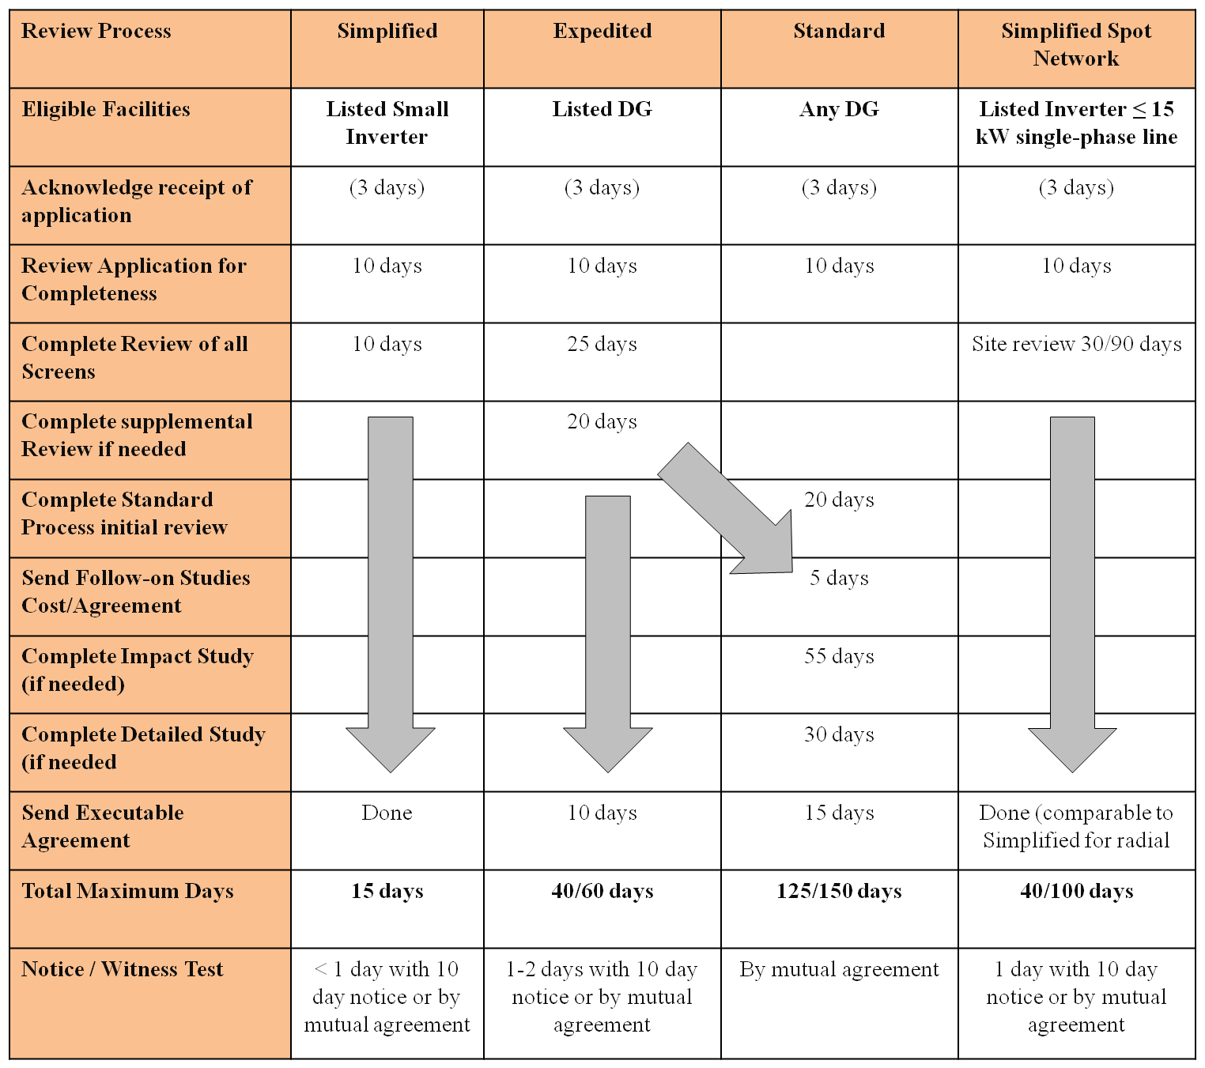
Review Paths Side-by-Side

Slide 12
Expedited and Standard Process Flowchart
Initial review and screening (25 days)
Provide Additional info
Information Exchange as needed
Yes
App complete (10 days)
Reviews needed?
Perform Supplemental
(20 days)
Acknowledge w/i 3 days
None
All rqmts determined
No
No
Customer submits application
Provide Additional info
Information Exchange as needed
Perform Studies
(55 days/30 days)
Yes
Send agreement (15 days)
Start
D Facility Modification needed
Customer pays for modifications
Yes
Complete system modifications
No
Customer
Customer signs agreement, builds facility, provides insurance, relay test results and test plan, pays for witness test, etc.
Utility
Relay Witness Test
Authorize Interconnect

Slide 13
Expedited and Standard Process Flowchart
Initial review and screening (25 days)
Provide Additional info
Information Exchange as needed
Yes
App complete (10 days)
Reviews needed?
Perform Supplemental
(20 days)
Acknowledge w/i 3 days
None
All rqmts determined
No
No
Customer submits application
Provide Additional info
Information Exchange as needed
Perform Studies
(55 days/30 days)
Yes
Send agreement (15 days)
Start
D Facility Modification needed
Customer pays for modifications
Yes
Complete system modifications
No
Customer
Customer signs agreement, builds facility, provides insurance, relay test results and test plan, pays for witness test, etc.
Utility
Relay Witness Test
Authorize Interconnect

Slide 14
Yes
App complete (10 days)
Customer submits application
Send agreement (60/150 days)
Start
Customer
Utility
Authorize Interconnect

Slide 15
Process Phases Using Existing Reporting
Yes
App complete (10 days)
2
3
Customer submits application
1
4
Send agreement (60/150 days)
Start
5
Customer
Utility
Authorize Interconnect

Slide 16
Customer
Utility

Slide 17
App. Deemed Complete
In Study
Application Rec’d
3
Rec’d
Agreement
4
Post-Agreement / Construction
Information Exchange
5
Customer
Utility
Authorized!

Slide 18
Projects Stuck at “Application Complete” Calendar Days Lapsed
App. Deemed Complete
In Study
Application Rec’d
628MW
Customer
Utility

Slide 19
Projects Stuck at “Application Complete” Calendar Days Lapsed
563 Projects 628 MW
Note: There are 37 Projects reported as “0” kW.
Standard:
210 calendar days
Size (kW)
Days

Slide 20
Projects that Received an Agreement
App. Deemed Complete
In Study
Application Rec’d
Rec’d
Agreement
99.5 MW
Customer
Utility

Slide 21
Expedited Projects – Time Lapsed for Received Agreement
Expedited Review Max Timeline: 84 calendar days
(Tariff: 60 business days)
378 Projects
39 MW
Size (kW)
Days

Slide 22
Standard Review Projects – Time Lapsed for Received Agreement
Standard Review Max Timeline: 210 calendar days
(Tariff: 150 business days)
59 Projects
60.5 MW
Size (kW)
Days

Slide 23
App. Deemed Complete
In Study
Application Rec’d
Rec’d
Agreement
Post-Agreement / Construction
41 MW
Customer
Utility

Slide 24
Post-Agreement Projects Awaiting Signature/Construction/Approval to Connect
Timelines for Construction are treated on a project by project basis by utility commitment in the Agreement.
207 Projects
41 MW
Size (kW)
Days

Slide 25
DG Applications Submitted vs. Processed Starting Jan 2009 (Cumulative kW)
-------- Applied
-------- Authorized

Slide 26
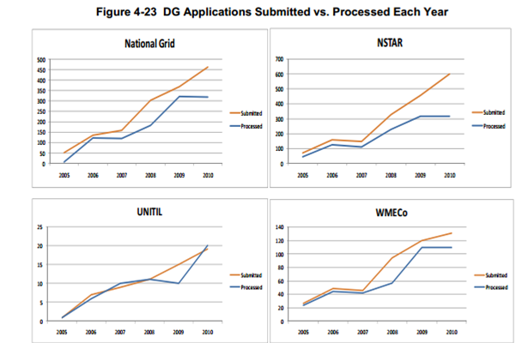

Slide 27
Figure 4.23: DG Applications Submitted vs. Processed Each Year (Cumulative kW)

Slide 28
NU-NSTAR DG Applications Submitted vs. Processed Each Year (Cumulative kW)
 | Applied | Authorized
2009 | 40,241 | 3,945
2010 | 147,465 | 13,209
2011 | 316,272 | 32,025
2012 | 395,651 | 43,695

Slide 29
National Grid DG Applications Submitted vs. Processed Each Year (Cumulative kW)
 | Applied | Authorized
2009 | 16,510 | 2,417
2010 | 79,741 | 13,523
2011 | 383,229 | 34,599
2012 | 502,718 | 50,960

Slide 30
NU-WMECo DG Applications Submitted vs. Processed Each Year (Cumulative kW)
 | Applied | Authorized
2009 | 10,492 | 555
2010 | 16,177 | 1,350
2011 | 32,750 | 4,301
2012 | 87,044 | 8,807

Slide 31
Unitil DG Applications Submitted vs. Processed Each Year (Cumulative kW)
 | Applied | Authorized
2009 | 0 | 0
2010 | 139 | 39
2011 | 2,541 | 551
2012 | 2,541 | 2,541

Slide 32
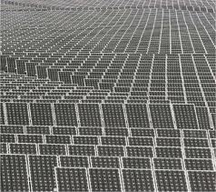
Freshness of Complete Applications Awaiting Agreement
Snapshot: November 2011
Should DOER update?
 |  | <84 Days | 84-210 Days | >210 Days | Total
<500kW | Apps | 37 | 11 | 10 | 58
 | Avg (MW) | 0.172 | 0.087 | 0.107
 | MW | 6.355 | 0.958 | 1.067 | 8.380
500kW-1MW | Apps | 54 | 23 | 14 | 91
 | Avg (MW) | 0.902 | 0.93 | 0.921
 | MW | 48.691 | 21.4 | 12.892 | 82.983
>1MW | Apps | 29 | 33 | 21 | 83
 | Avg (MW) | 2.754 | 1.931 | 2.066
 | MW | 79.859 | 63.724 | 43.384 | 186.967
Total | Apps | 120 | 67 | 45 | 232
 | Avg (MW) | 1.125 | 1.284 | 1.267
 | MW | 135.000 | 86.000 | 57.000 | 278.000
79.9
63.7
43.4
48.7
21.4
12.9
6.4
1.0
1.1
<500kW 500kW-1MW >1MW
<500kW 500kW-1MW >1MW
<500kW 500kW-1MW >1MW
< 84 Days
> 210 Days

Slide 33
Freshness of Complete Applications Awaiting Agreement (distribution by size)
79.9
Snapshot: November 2011
Should DOER update?
63.7
48.7
43.4
21.4
6.4
1.0
1.1
12.9
<500kW 500kW-1MW >1MW
<500kW 500kW-1MW >1MW
<500kW 500kW-1MW >1MW
< 84 Days
84-210 Days
> 210 Days

